Slide 1
Chapter 3: Using Methods, Classes, and Objects

Slide 2
Objectives
Learn about method calls and placement
Identify the parts of a method
Add parameters to methods
Create methods that return values
Learn about classes and objects
Create a class
Create instance methods in a class
Java Programming, Eighth Edition

Slide 3
Objectives (cont’d.)
Declare objects and use their methods
Create constructors
Appreciate classes as data types
Java Programming, Eighth Edition

Slide 4
Understanding Method Calls and Placement
Method
  A program module
  Contains a series of statements
  Carries out a task
Execute a method
  Invoke or call from another method
Calling method (client method)
  Makes a method call
Called method
  Invoked by a calling method
Java Programming, Eighth Edition

Slide 5
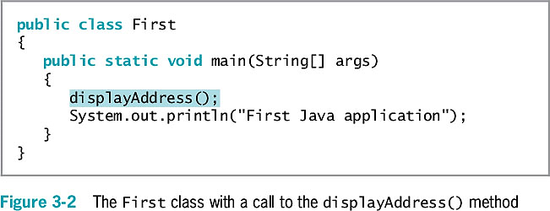
Understanding Method Calls and Placement (cont’d.)
Java Programming, Eighth Edition

Slide 6
Understanding Method Calls and Placement (cont’d.)
main() method executes automatically
Other methods are called as needed
Java Programming, Eighth Edition

Slide 7
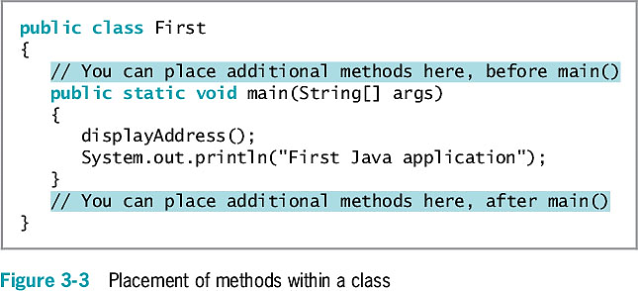
Understanding Method Calls and Placement (cont’d.)
Java Programming, Eighth Edition

Slide 8
Understanding Method Construction
A method must include:
  Method header
    Also called a declaration
  Method body
    Between a pair of curly braces
    Contains the statements that carry out the work
    Also called implementation
Java Programming, Eighth Edition

Slide 9
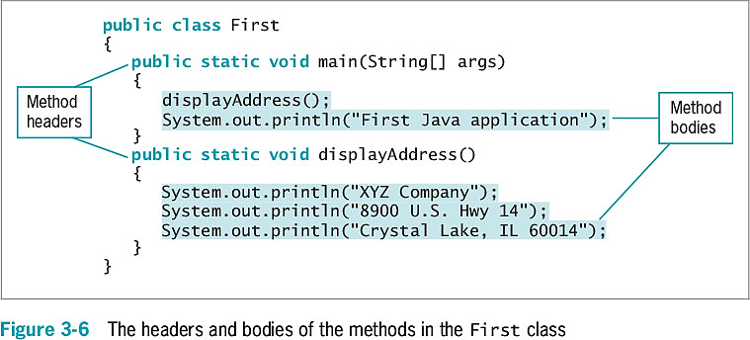
Understanding Method Construction (cont’d.)
Java Programming, Eighth Edition

Slide 10
Understanding Method Construction (cont’d.)
The method header contains:
  Optional access specifiers
  A return type
  An identifier
  Parentheses
    Might contain data to be sent to the method
Place the entire method within the class that will use it
  Not within any other method
Java Programming, Eighth Edition

Slide 11
Access Specifiers
Can be public, private, protected , or package
public access allows use by any other class
Also called access modifiers
Methods most commonly use public access
Java Programming, Eighth Edition

Slide 12
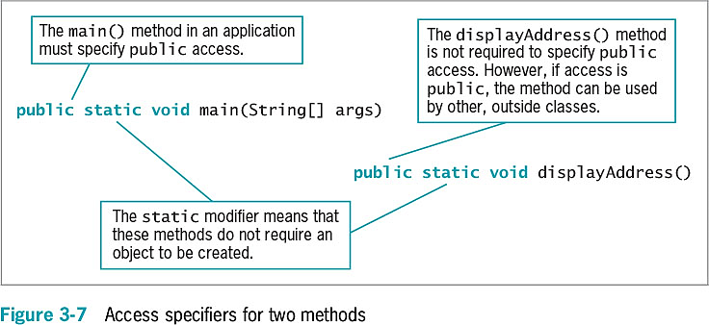
Access Specifiers (cont’d.)
Java Programming, Eighth Edition

Slide 13
Return Type
Describes the type of data the method sends back to the calling method
If no data is returned to the method, the return value is void
Java Programming, Eighth Edition

Slide 14
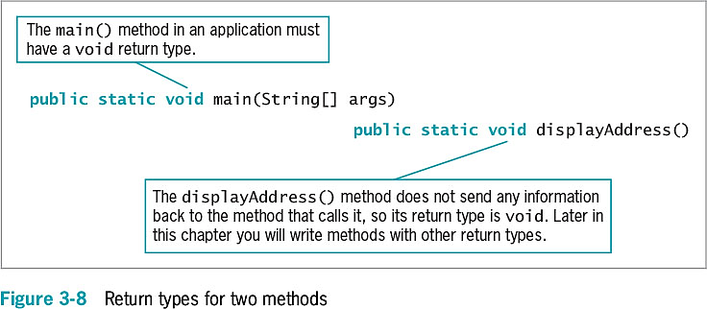
Return Type (cont’d.)
Java Programming, Eighth Edition

Slide 15
Method Name
Can be any legal identifier
  Must be one word
  No embedded spaces
  Cannot be a Java keyword
Java Programming, Eighth Edition

Slide 16
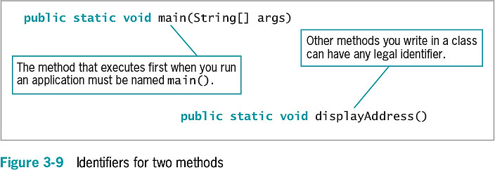
Method Name (cont’d.)
Java Programming, Eighth Edition

Slide 17
Parentheses
Every method header contains a set of parentheses that follow the identifier
May contain data to be sent to the method
Fully qualified identifier
  A complete name that includes the class
Java Programming, Eighth Edition

Slide 18
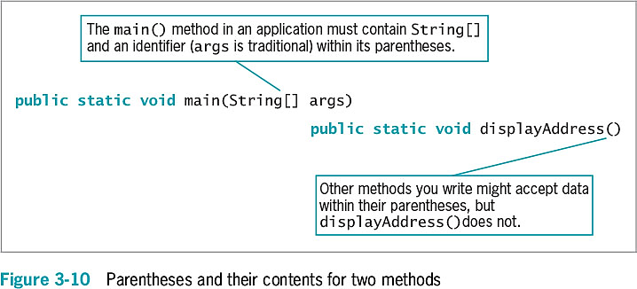
Parentheses (cont’d.)
Java Programming, Eighth Edition

Slide 19
Adding Parameters to Methods
Arguments
  Data items you use in a call to a method
Parameters
  Data items received by the method
Implementation hiding
  Encapsulation of method details within a class
  The calling method needs to understand only the interface to the called method
  Interface
    The only part of a method that the client sees or with which it interacts
Java Programming, Eighth Edition

Slide 20
Creating a Method That Receives a Single Parameter
Define the following:
  Optional access specifiers
  Return type for the method
  Method name
  Parameter type
  Local name for the parameter
Java Programming, Eighth Edition

Slide 21
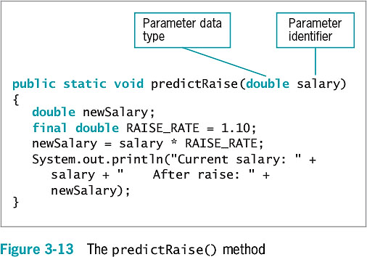
Creating a Method That Receives a Single Parameter (cont’d.)
Java Programming, Eighth Edition

Slide 22
Creating a Method That Receives a Single Parameter (cont’d.)
Local variable
  Known only within the boundaries of the method
  Each time the method executes:
    The variable is redeclared
    A new memory location large enough to hold the type is set up and named
Java Programming, Eighth Edition

Slide 23
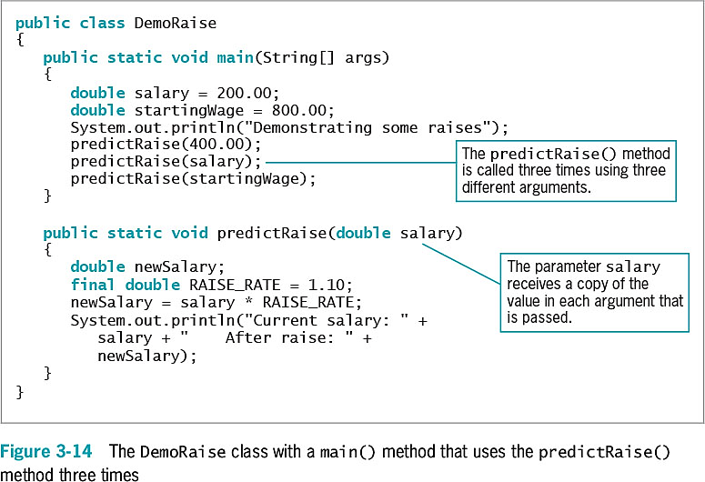
Creating a Method That Receives a Single Parameter (cont’d.)
Java Programming, Eighth Edition

Slide 24
Creating a Method That Requires Multiple Parameters
A method can require more than one parameter
List the arguments within the call to the method
  Separate with commas
Call a method
  Arguments sent to the method must match the parameters listed in the method declaration by:
    Number
    Type
Java Programming, Eighth Edition

Slide 25
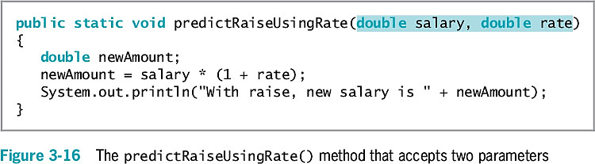
Creating a Method That Requires Multiple Parameters (cont’d.)
Java Programming, Eighth Edition

Slide 26
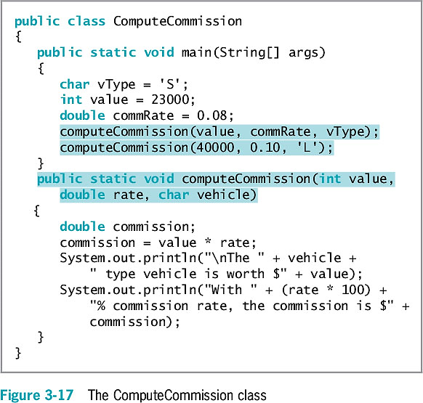
Creating a Method That Requires Multiple Parameters (cont’d.)
Java Programming, Eighth Edition

Slide 27
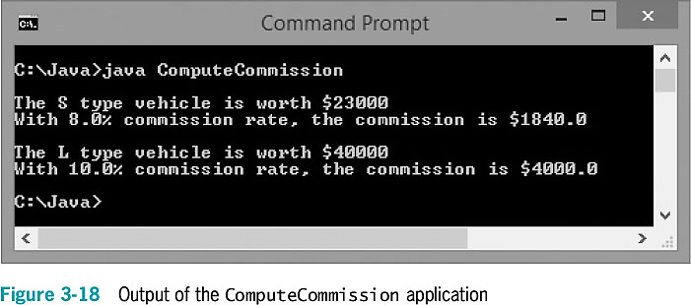
Creating a Method That Requires Multiple Parameters (cont’d.)
Java Programming, Eighth Edition

Slide 28
Creating Methods That Return Values
return statement
  Causes a value to be sent from the called method back to the calling method
The return type can be any type used in Java
  Primitive types
  Class types
  void
    Returns nothing
Method’s type
  A method’s return type
Java Programming, Eighth Edition

Slide 29
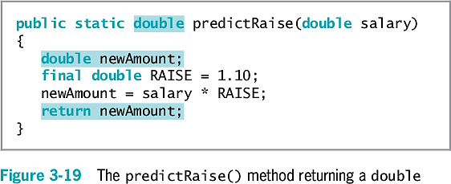
Creating Methods That Return Values (cont’d.)
Java Programming, Eighth Edition

Slide 30
Creating Methods That Return Values (cont’d.)
Unreachable statements (dead code)
  Logical flow leaves the method at the return statement
  Can never execute
    Causes a compiler error
Java Programming, Eighth Edition

Slide 31
Chaining Method Calls
Any method might call any number of other methods
Method acts as a black box
  Do not need to know how it works
  Just call and use the result
Java Programming, Eighth Edition

Slide 32
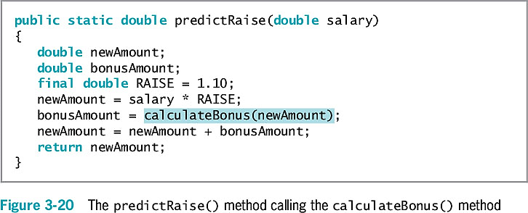
Chaining Method Calls (cont’d.)
Java Programming, Eighth Edition

Slide 33
Learning About Classes and Objects
Every object is a member of a class
Is-a relationships
  An object “is a” concrete example of the class
  The zoo’s shark “is a” Fish
Instantiation
  Shark is an instantiation of the Fish class
Reusability
Java Programming, Eighth Edition

Slide 34
Learning About Classes and Objects (cont’d.)
Methods are often called upon to return a piece of information to the source of the request
Class client or class user
  An application or a class that instantiates objects of another prewritten class
Java Programming, Eighth Edition

Slide 35
Creating a Class
Assign a name to the class
Determine what data and methods will be part of the class
Create a class header with three parts:
  An optional access modifier
  The keyword class
  Any legal identifier for the name of the class
public class
  Accessible by all objects
Java Programming, Eighth Edition

Slide 36
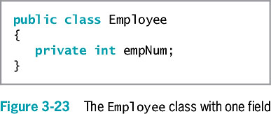
Creating a Class (cont’d.)
Java Programming, Eighth Edition

Slide 37
Creating a Class (cont’d.)
Extended
  To be used as a basis for any other class
Data fields
  Variables declared within a class but outside of any method
Instance variables
  Nonstatic fields given to each object
Java Programming, Eighth Edition

Slide 38
Creating a Class (cont’d.)
Private access for fields
  No other classes can access the field’s values
  Only methods of the same class are allowed to use private variables
Information hiding
Most class methods are public
Java Programming, Eighth Edition

Slide 39
Creating Instance Methods in a Class
Classes contain methods
  Mutator methods
    Set or change field values
  Accessor methods
    Retrieve values
  Nonstatic methods
    Instance methods
    “Belong” to objects
Typically declare nonstatic data fields
static class variables are not instance variables
Java Programming, Eighth Edition

Slide 40
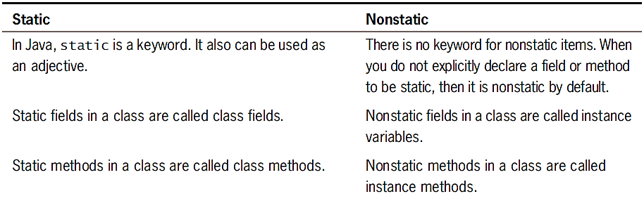
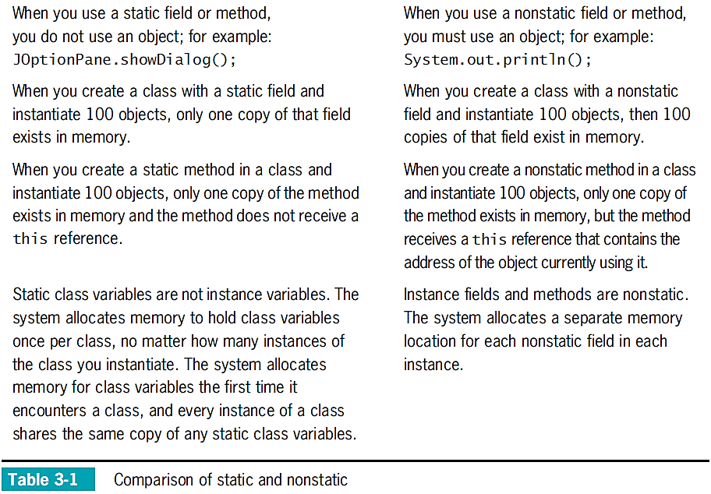
Java Programming, Eighth Edition

Slide 41
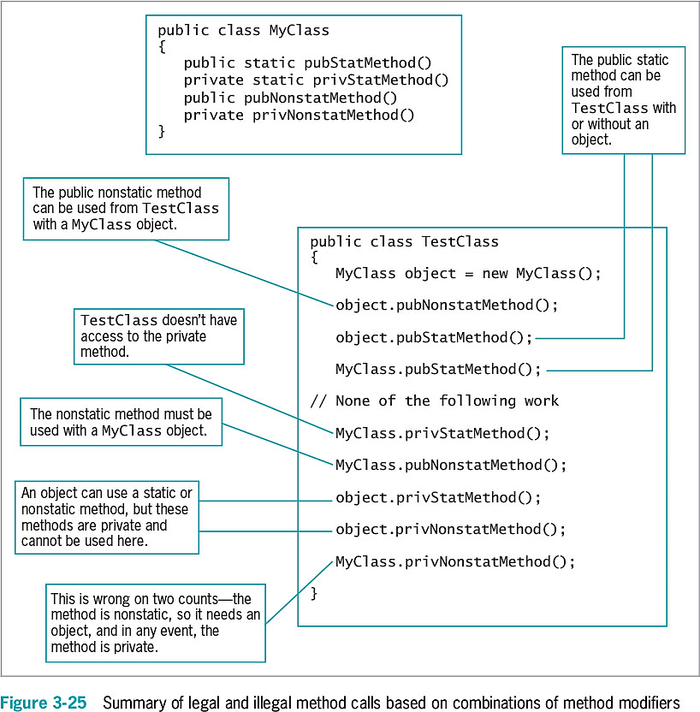
Java Programming, Eighth Edition

Slide 42
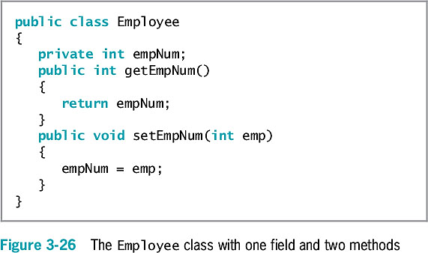
Creating Instance Methods in a Class (cont’d.)
Java Programming, Eighth Edition

Slide 43
Organizing Classes
Place data fields in logical order
  At the beginning of a class
  List the fields vertically
Data fields and methods may be placed in any order within a class
  It’s common to list all data fields first
  Names and data types can be seen before reading the methods that use the data fields
Java Programming, Eighth Edition

Slide 44
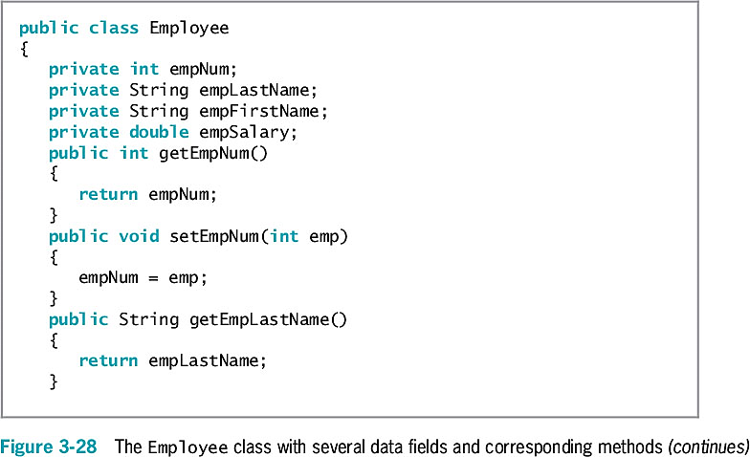
Organizing Classes (cont’d.)
Java Programming, Eighth Edition

Slide 45
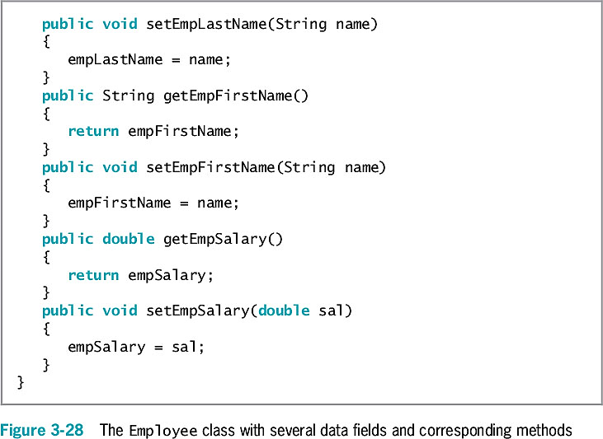
Organizing Classes (cont’d.)
(continued)
Java Programming, Eighth Edition

Slide 46
Declaring Objects and Using
Their Methods
Declaring a class does not create any actual objects
To create an instance of a class:
  Supply a type and an identifier
  Allocate computer memory for the object
  Use the new operator
    Employee someEmployee;
    someEmployee = new Employee();
  or
    Employee someEmployee = new Employee();
Java Programming, Eighth Edition

Slide 47
Declaring Objects and Using
Their Methods (cont’d.)
Reference to the object
  The name for a memory address where the object is held
Constructor method
  A method that creates and initializes class objects
  You can write your own constructor methods
  Java writes a constructor when you don’t write one
  The name of the constructor is always the same as the name of the class whose objects it constructs
Java Programming, Eighth Edition

Slide 48
Declaring Objects and Using
Their Methods (cont’d.)
After an object is instantiated, its methods can be accessed using:
  The object’s identifier
  A dot
  A method call
Java Programming, Eighth Edition

Slide 49
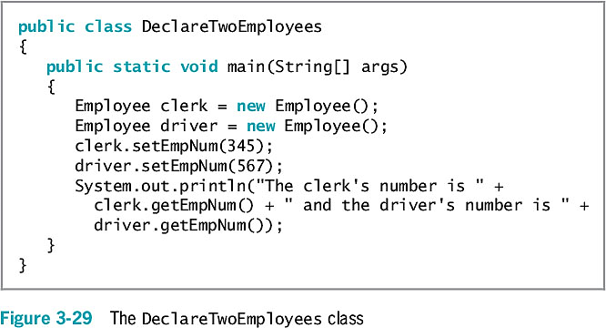
Declaring Objects and Using
Their Methods (cont’d.)
Java Programming, Eighth Edition

Slide 50
Understanding Data Hiding
Data hiding using encapsulation
  Data fields are usually private
  The client application accesses them only through public interfaces
set method
  Controls the data values used to set a variable
get method
  Controls how a value is retrieved
Java Programming, Eighth Edition

Slide 51
An Introduction to Using
Constructors
Employee chauffeur = new Employee();
  Actually a calling method named Employee()
Default constructors
  Require no arguments
  Created automatically by a Java compiler
    For any class
    Whenever you do not write a constructor
Java Programming, Eighth Edition

Slide 52
An Introduction to Using
Constructors (cont’d.)
The default constructor provides specific initial values to an object’s data fields
  Numeric fields
    Set to 0 (zero)
  Character fields
    Set to Unicode ‘\u0000’
  Boolean fields
    Set to false
  Nonprimitive object fields
    Set to null
Java Programming, Eighth Edition

Slide 53
An Introduction to Using
Constructors (cont’d.)
A constructor method:
  Must have the same name as the class it constructs
  Cannot have a return type
  public access modifier
Java Programming, Eighth Edition

Slide 54
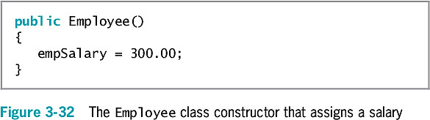
An Introduction to Using
Constructors (cont’d.)
Java Programming, Eighth Edition

Slide 55
Understanding That Classes Are
Data Types
Classes you create become data types
  Often referred to as abstract data types (ADTs)
    Implementation is hidden and accessed through public methods
  Programmer-defined data type
    Not built into the language
Declare an object from one of your classes
  Provide the type and identifier
Java Programming, Eighth Edition

Slide 56
You Do It
Creating a static Method that Requires No Arguments and Returns No Values
Creating static Methods that Accept Arguments and Return a Value
Creating a Class that Contains Instance Fields and Methods
Declaring and Using Objects
Adding a Constructor to a Class
Understanding that Classes are Data Types
Java Programming, Eighth Edition

Slide 57
Don’t Do It
Don’t place a semicolon at the end of a method header
Don’t think “default constructor” means only the automatically supplied constructor
Don’t think that a class’s methods must:
  Accept its own fields’ values as parameters
  Return values to its own fields
Don’t create a class method that has a parameter with the same identifier as a class field
Java Programming, Eighth Edition

Slide 58
Summary
Method
  A series of statements that carry out a task
    A declaration includes the parameter type and local name for a parameter
    You can pass multiple arguments to methods
  Has a return type
Class objects
  Have attributes and methods associated with them
Instantiate objects that are members of a class
Java Programming, Eighth Edition

Slide 59
Summary (cont’d.)
Constructor
  A method establishes an object and provides specific initial values for an object’s data fields
Everything is an object
  Every object is a member of a more general class
Implementation hiding, or encapsulation
  private data fields
  public access methods
Java Programming, Eighth Edition

